Slide 1
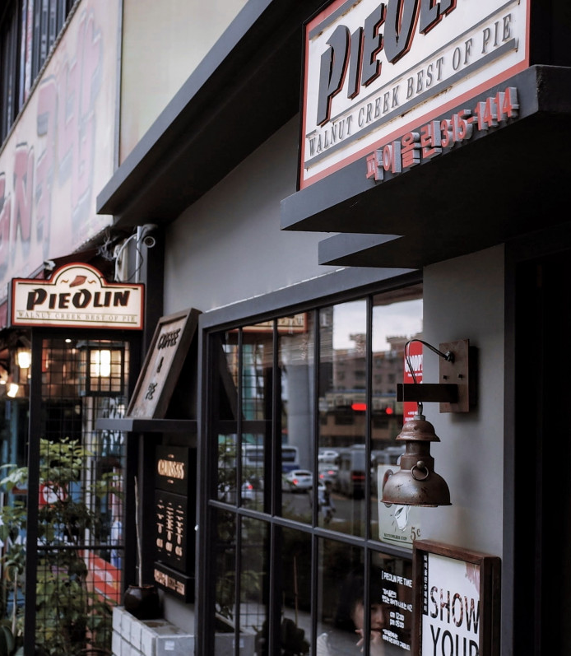
Presented by:
AAMNA SHAIK
Reg no:573CS23007
Course: PROJECT MANAGEMENT SKILLS

Slide 2
Agenda
Introduction
Risks
Overcoming challenges
Summary
Challenges
Presentation Title

Slide 3
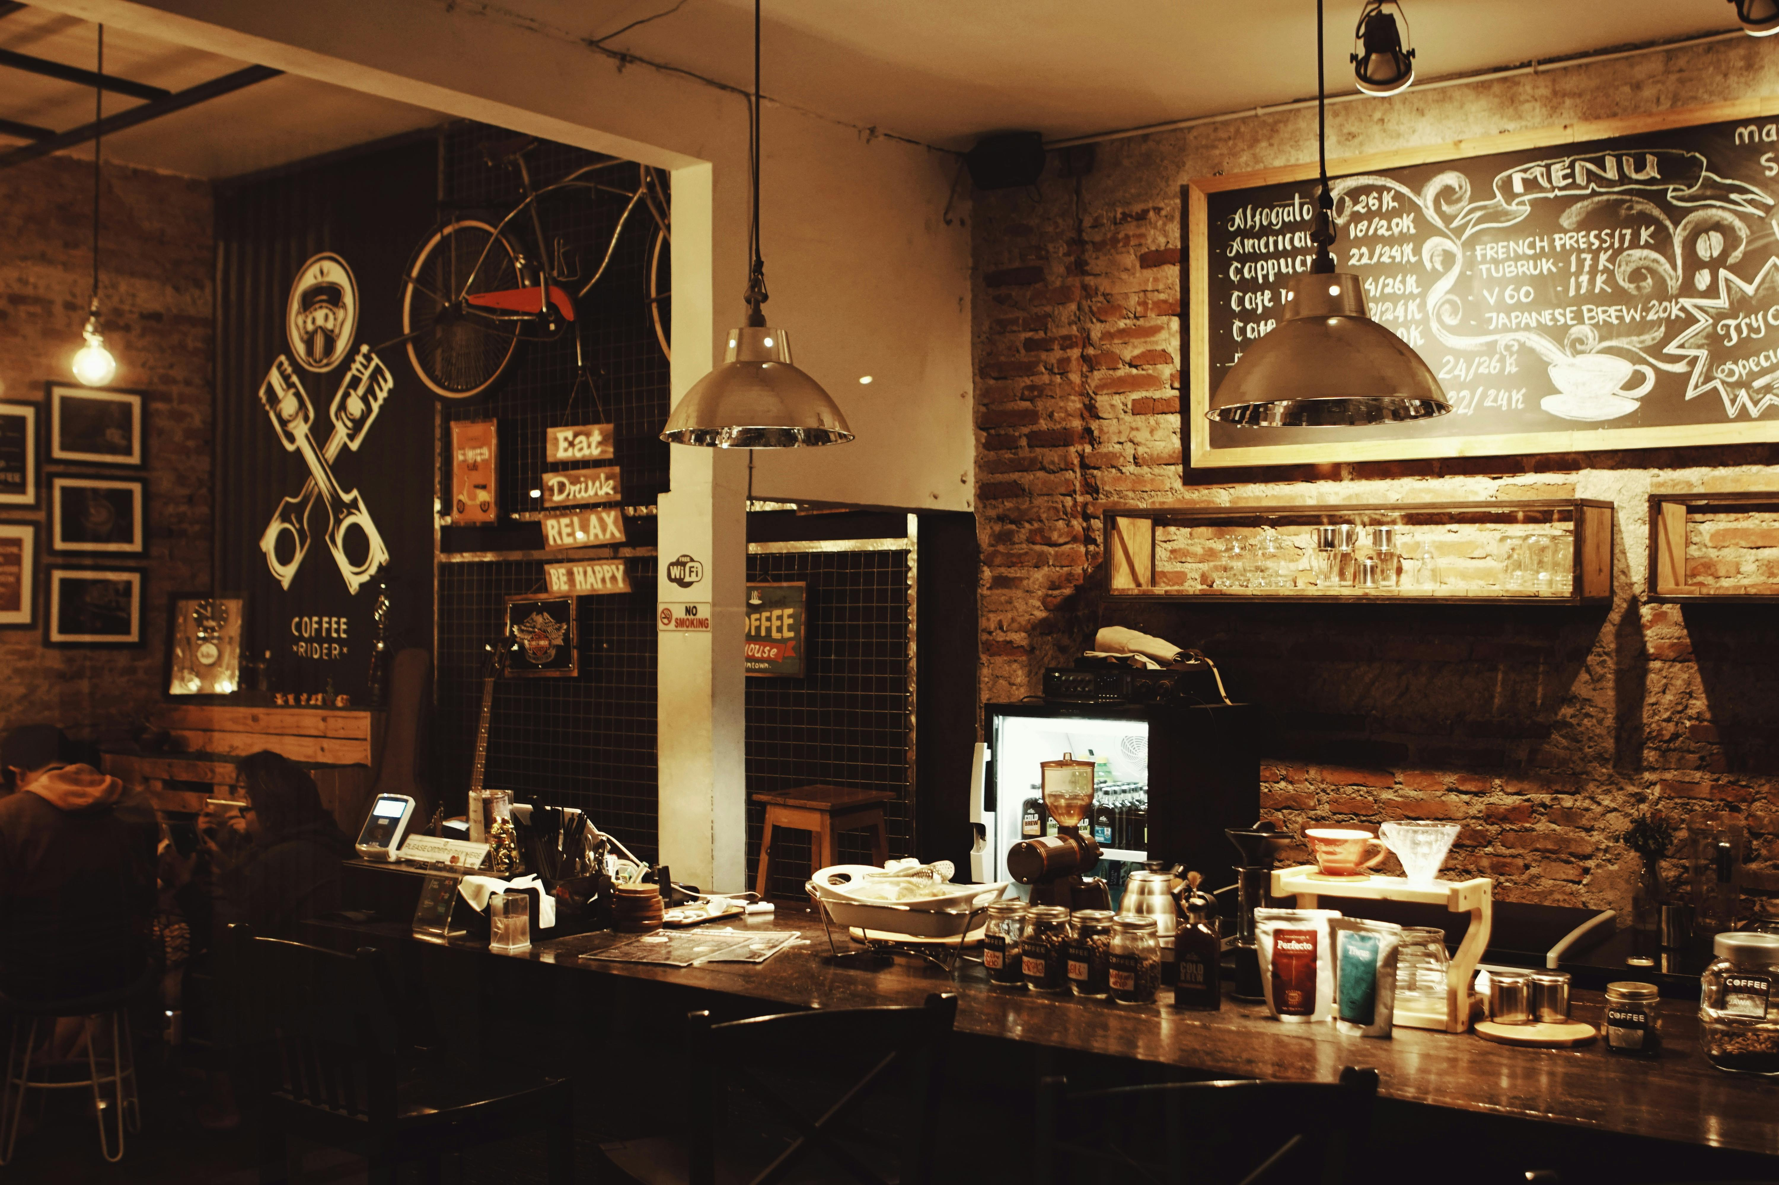
Introduction

Slide 4
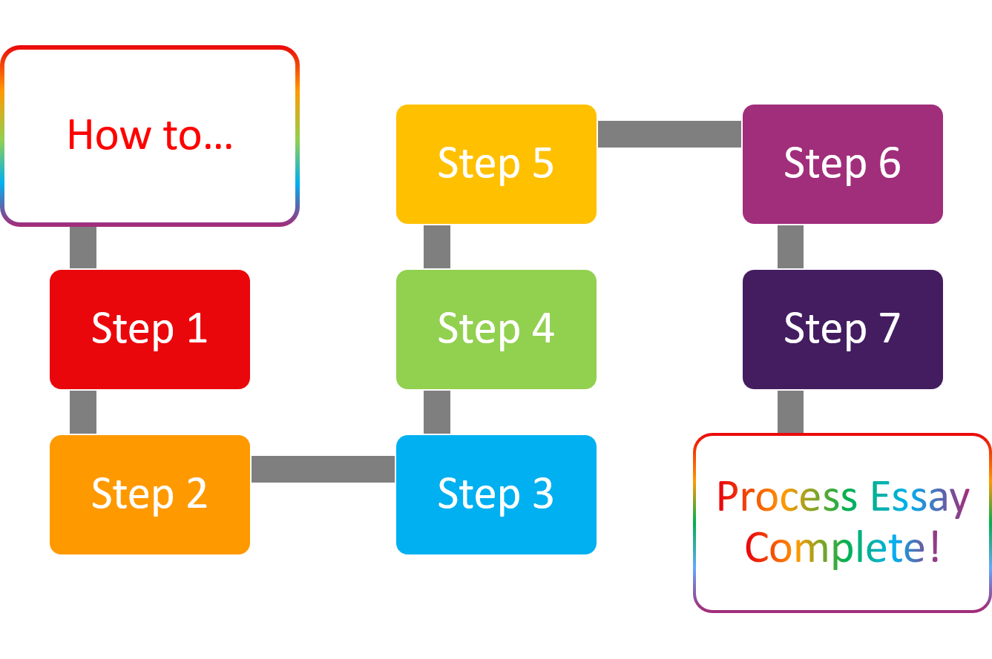
STARTING UP A CAFÉ -Market research -Business plan -Location -Legal requirements -Interior design -Equipments and Supplies -Hiring staff -Marketing and promotion -Launch
This Photo by Unknown Author is licensed under CC BY

Slide 5

RISKS OF THE STARTUP
Strong competetion

Slide 6
IDEAS FOR GROWTH/DEVELOPMENT OF CAFE
Unique theme or concept
Interactive Experiences
Local and sustainable sourcing
Community engagement
Flexible seating arrangement
Tech integration
Art and Entertainment
Heathy and Dietary-friendly options
Personalized service
Adapting to Digital marketing
Personal selling

Slide 7
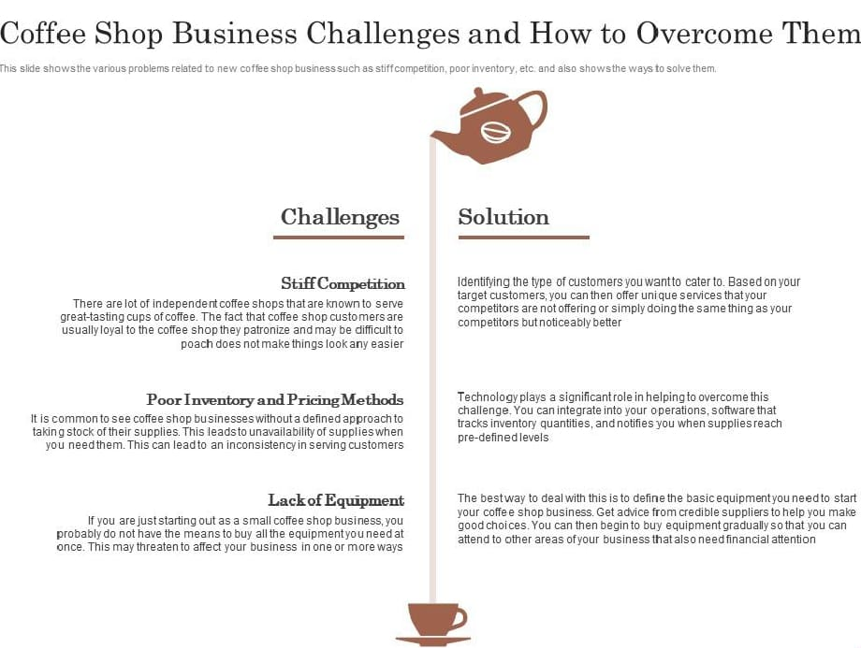

Slide 8





Plan for cafe’s launch
Planning
Marketing
Design
Strategy
Launch
Synergize scalable e-commerce
Disseminate standardized
metrics
Coordinate
e-business applications
Foster holistically superior methodologies
Deploy strategic networks with compelling
e-business needs

Slide 9


Summary
At Contoso, we believe in giving 110%. By using our next-generation data architecture, we help organizations virtually manage agile workflows. We thrive because of our market knowledge and great team behind our product. As our CEO says, “Efficiencies will come from proactively transforming how we do business.”

Slide 10
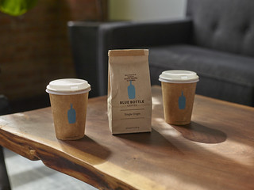



Thank you

